Slide 1

TripAdvisor Restaurant Reviews - Sentiment Analysis using ML and Rule-Based Models
CS 532 Systems for Data Science
Final Project Presentation
Sarah Boal, Albert Galimov, Jordan Jauch, Fiona McGowan
Notes:
Fiona

Slide 2
Objective
Fetch Trip Advisor customer reviews for restaurants in New York City from a Kaggle Dataset :
Source : https://www.kaggle.com/datasets/rayhan32/trip-advisor-newyork-city-restaurants-dataset-10k
Category: TripAdvisor Restaurant Reviews (7,237 Unique Values)
Compare the performance of various sentiment analysis models in training and run time with different batch sizes
Notes:
Fiona
various sentiment analysis models: using rules-based approach and an ML approach

Slide 3
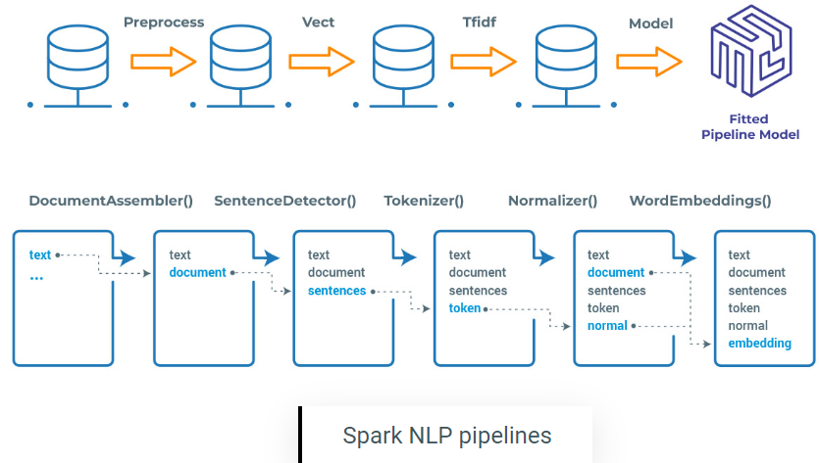
Spark NLP Pipeline
Source : https://www.johnsnowlabs.com/sentiment-analysis-with-spark-nlp-without-machine-learning/
Notes:
Fiona
This shows the sequence of processes in a typical NLP pipeline. Spark NLP comes with pretrained pipelines and models which we used in our project. Using the pipeline, We Preprocessed the text into tokens and then used a pretrained NLP model to perform the sentiment analysis

Slide 4
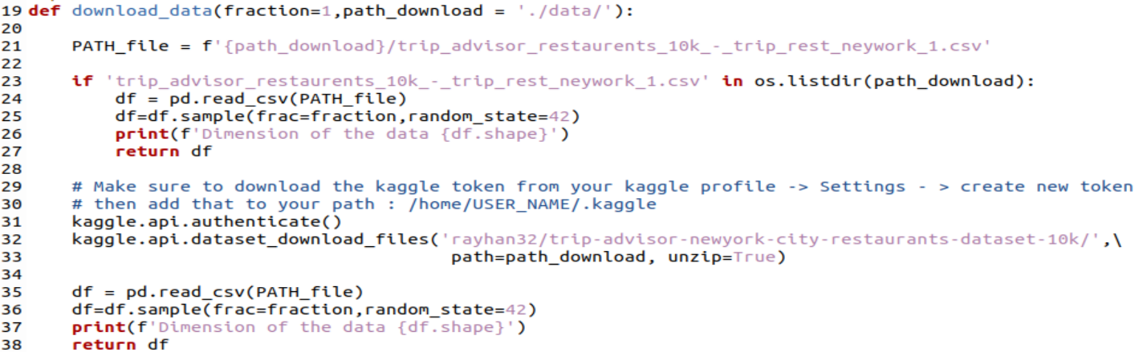

Data Retrieval and Preprocessing
Download the data from the file path of the Kaggle dataset CSV file :
Create a dataframe from the kaggle dataset CSV file
Notes:
Fiona
We downloaded the CSV file from Kaggle. this is a typical data download function to retrieve and fetch the data. We initially looked at TripAdvisor API if we had access to an API we could use this function to download the data from API to store locally or on a database like SQL

Slide 5
Testing Different Models
Spark NLP
Open Source Library maintained by John Snow Labs, built on Apache Spark and Spark ML for Natural Language Processing
Spark NLP contains more than 14,500 pretrained pipelines and models
Each step contains an annotator that performs tokenization, normalization, dependency parsing
Source : https://www.johnsnowlabs.com/mastering-text-classification-with-spark-nlp/
Notes:
Sarah

Slide 6
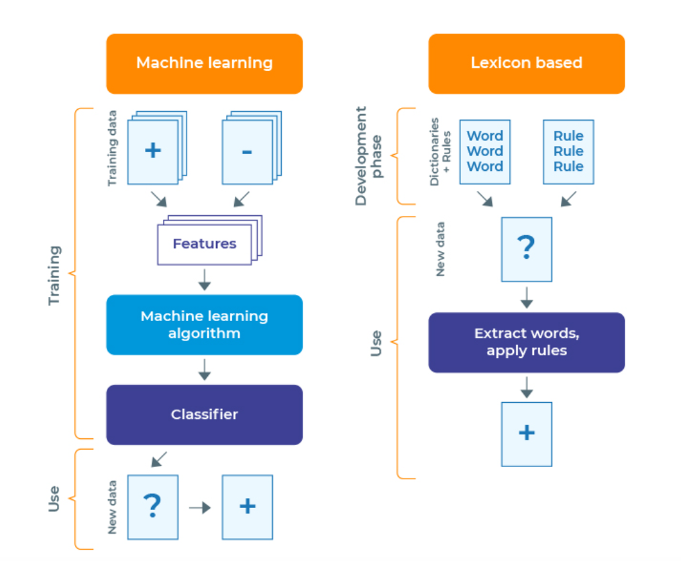
Rule - based vs Machine learning - SPARK NLP
Source : https://www.johnsnowlabs.com/sentiment-analysis-with-spark-nlp-without-machine-learning/
Notes:
Sarah
Rule-based sentiment analysis involves defining a set of rules or patterns based on specific linguistic/dataset knowledge. For finding the positivity of reviews, this would include rules that classify a review as positive if it contains positive adjectives or negative if it contains negative ones.
Using ML models for sentiment analysis involves training labeled data to learn and identify patterns and then classify texts of unseen data
rule-based systems use rules that are explicitly defined and therefore can be more interpretable; however, they can be less flexible and less effective for complex patterns in data. ML (and DL) models can be better at identifying complex patterns but can be less interpretable and require more training data to be accurate.

Slide 7
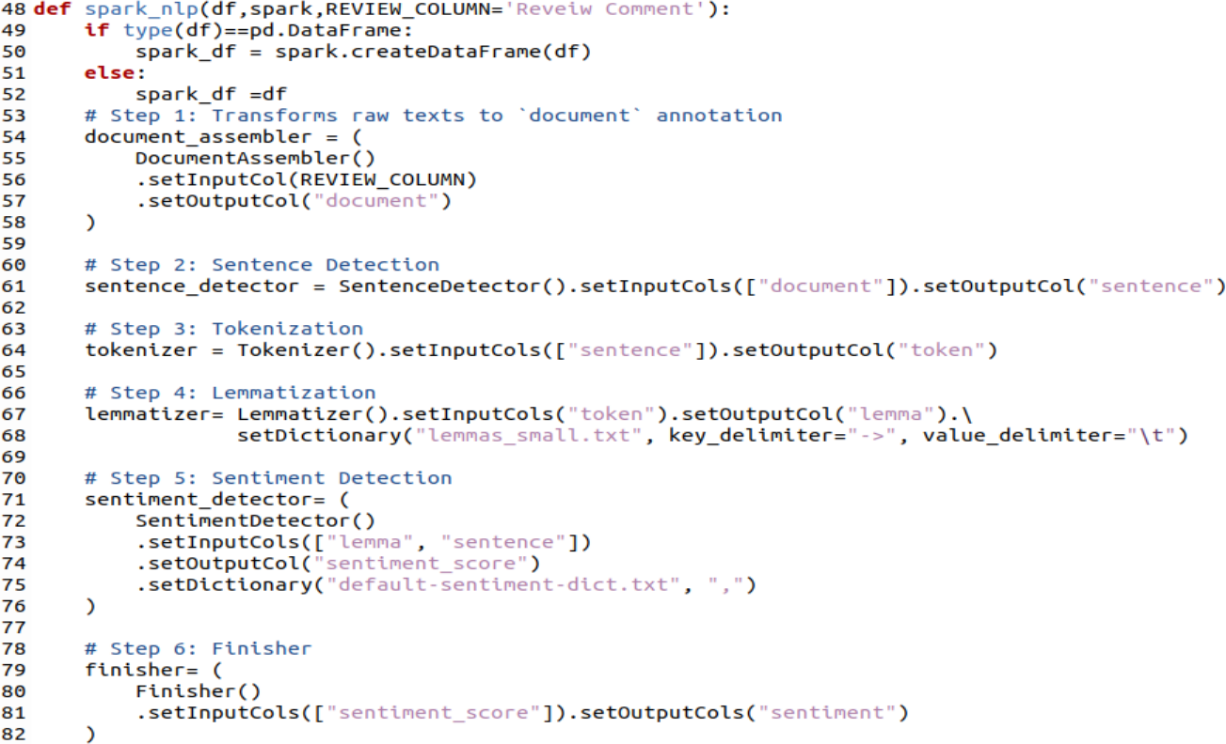
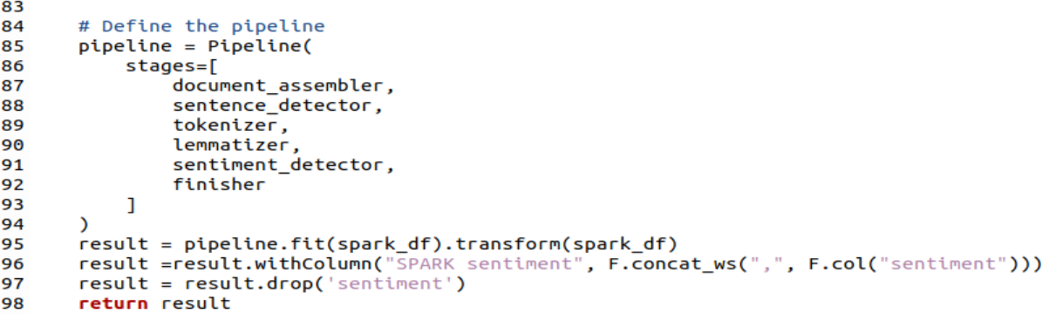
Testing Different Models
Model #1 : Rule-based model (Spark NLP)
Code Snapshot :
Notes:
Sarah
First model implemented using the Spark NLP library
Sentence Detection identifies and segments text into individual sentences using the Spark NLP library, then performs tokenization. Lemmatizer is added to the pipeline as the 4th stage to find lemmas out of words with the objective of returning a base dictionary word. SentimentDetector is the 5th stage in the pipeline that scores the sentiments, then the predicted sentiment is displayed as a dataframe.

Slide 8
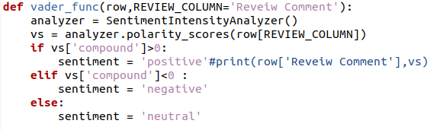
Testing Different Models
Model #2 : VADER Sentiment Analysis (Valence Aware Dictionary and Sentiment Reasoner) - Rule based
Lexicon and rule-based sentiment analysis tool for sentiments in social media.
Open sourced under the MIT License
Notes:
Albert

Slide 9
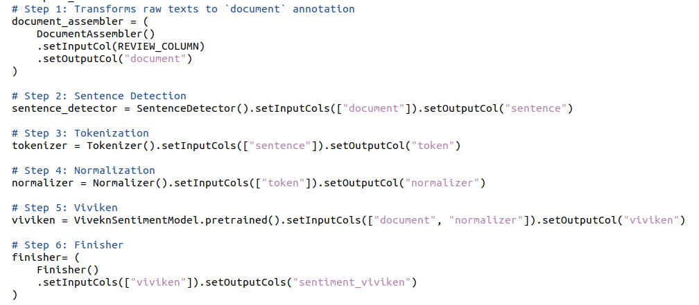
Testing Different Models
Model #3 : Viviken - Pretrained ML model (SPARK NLP)
Notes:
Albert

Slide 10
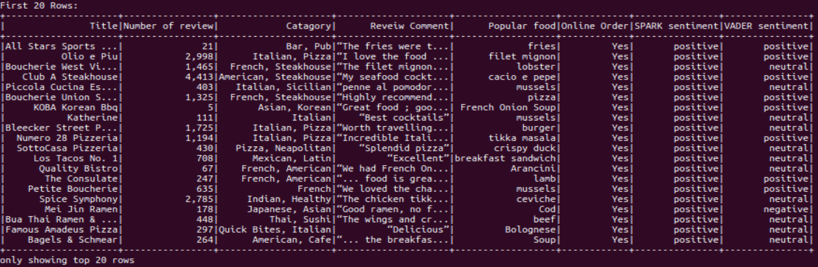
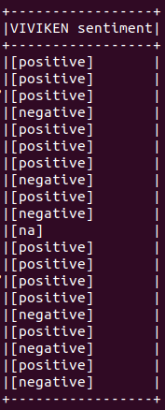
Experimental Results
Sample Output (First 20 rows)
VADER and VIVIKEN Sentiment Analysis are less accurate, because most reviews should be positive in this dataset.
Notes:
Albert

Slide 11
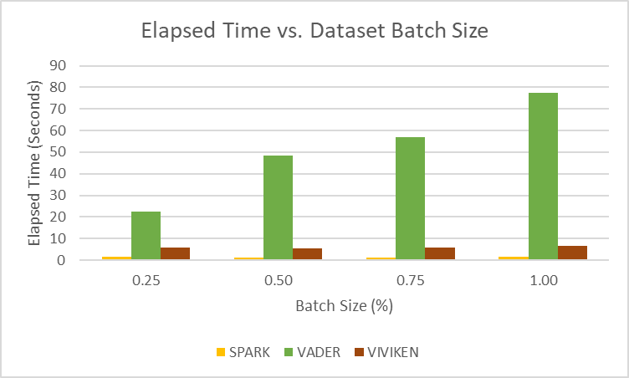
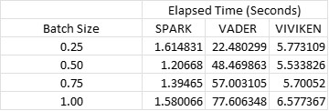
Experimental Results
Changes in Elapsed Runtime vs. Data Batch Size
VADER is a rule-based NLP model that has many rules and therefore takes more time to run than the other two models
Notes:
Jordan
VIVIKEN is fast after the first run because it’s a machine learning pretrained model. VADER runs slower because it’s a rule-based model. SPARK runs fast because it is optimized for distributed processing.

Slide 12
Possible Improvements
Improve the Deep Learning Model that we already started developing, to expand on the sentiment analysis capabilities
Expand the dataset to include more restaurant reviews, and pull data from a TripAdvisor API
Originally we had planned to use a TripAdvisor API but had challenges with obtaining a large dataset with all of the restrictions on TripAdvisor reviews
Clean up the Dataset to remove punctuation, emojis, change all words to lowercase, etc.
In the future, we can try to run this program on a GPU and chart the runtime results in different batch sizes
Compare the accuracy of each model on a different dataset that contains the actual sentiment values (the kaggle dataset used did not contain the actual sentiment values)
Notes:
Jordan

Slide 13
Goals
Goal #1: Take data from TripAdvisor API and store as our dataset
TripAdvisor API limited the number of reviews that could be extracted, therefore we had to switch to using a Kaggle dataset that had thousands of TripAdvisor restaurant reviews already included.
Dataset from Kaggle did not require a lot of preprocessing because it was organized and labelled
Goal #2: Build a model in Pyspark as a dataframe and RDD and compare the run time between the two methods
All of the sentiment analysis models are using dataframe (Spark NLP), RDD has been phased out and is very difficult to use with existing models (Spark MLlib)
This goal was completed using the Spark NLP and VADER analysis, and then we compared the elapsed runtime of each with different batch sizes
A future goal would be to implement a Deep Learning model and compare it to the other models already tested
Also, we could investigate more of how the models use memory of the system, and their differences
Notes:
Jordan

